Slide 1
Final Project: Uni Sufferers
Maaz Ahmed
Abraiz Azhar

Slide 2
Introduction
Inspired by Hazem’s approach of creating an NYUAD specific game.
Credit to Abraiz for the drawings in the following slides.
Concept of this game is raising mental health awareness as university gets extremely demanding for most freshmen.
This game involves a student (represented by Faiza the Falcon) avoiding multiple obstacles on their way to taking care of their mental health.
The obstacles represent some of the difficulties faced by freshmen this semester.
We will be showing a mock display of another game with different sprites in order to demonstrate some of the functionalities of our game.

Slide 3
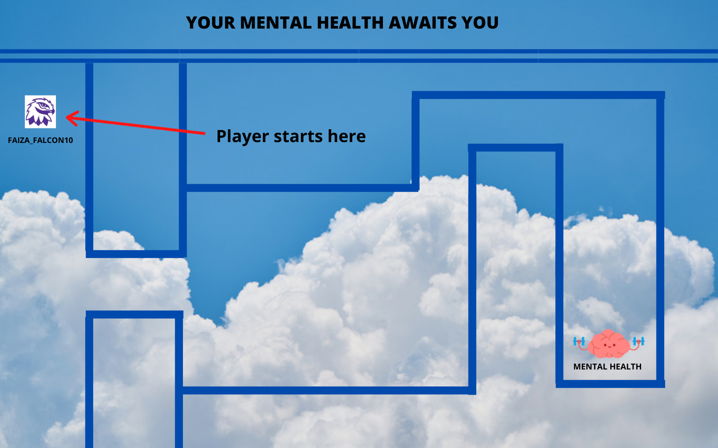

Slide 4
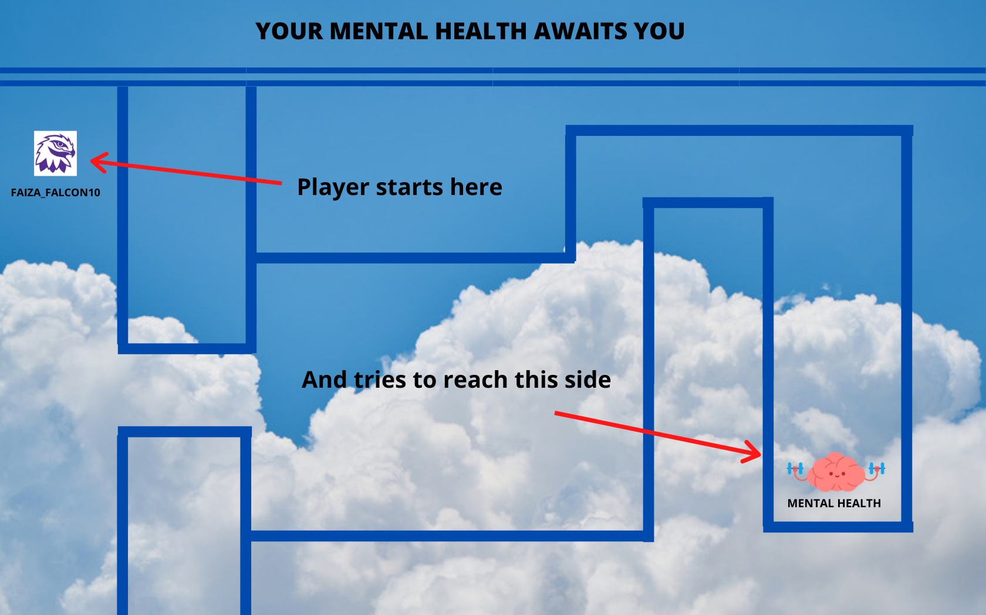

Slide 5
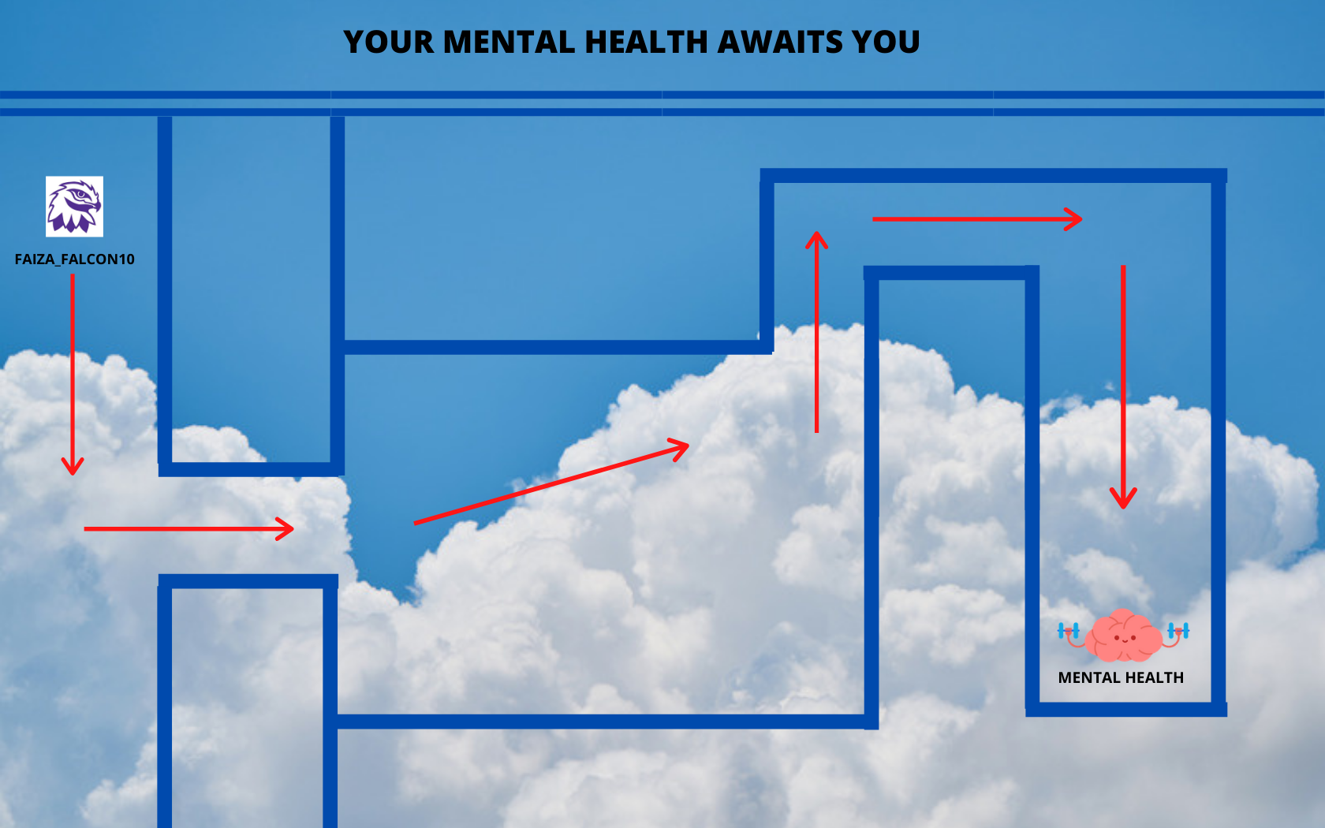

Slide 6
OBSTACLES
In order to pass the upcoming levels, the player must avoid certain obstacles.
The first obstacle is an alarm clock which symbolizes 5a.m classes.
The clock only moves sideways and if the player comes into contact with the clock, he/she is respawned at the starting point.
Coming into contact with any of the obstacles that prevent the player from reaching his mental health increases the ‘Mental Breakdown’ count by one.

Slide 7
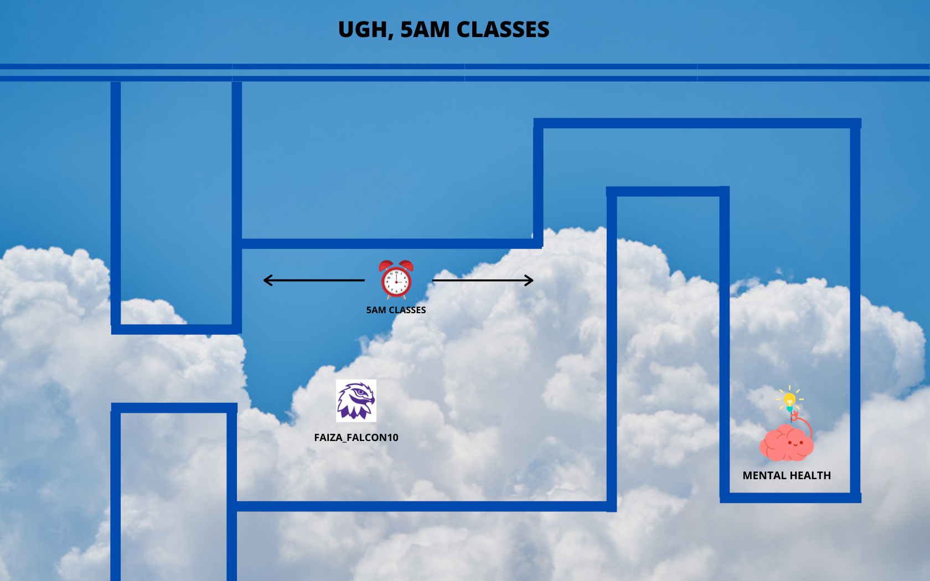

Slide 8
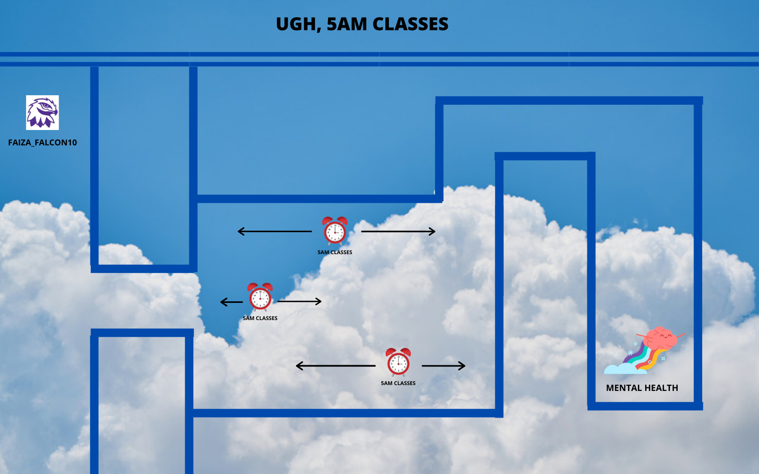

Slide 9
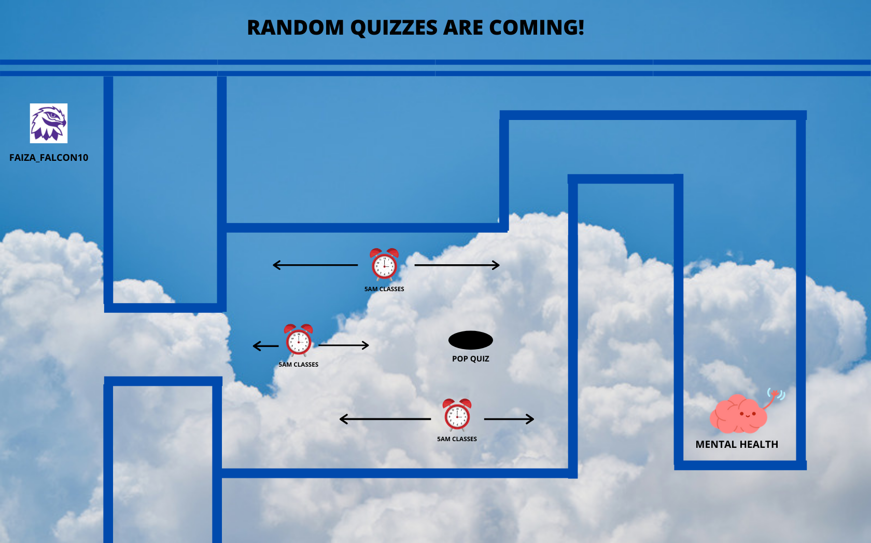

Slide 10
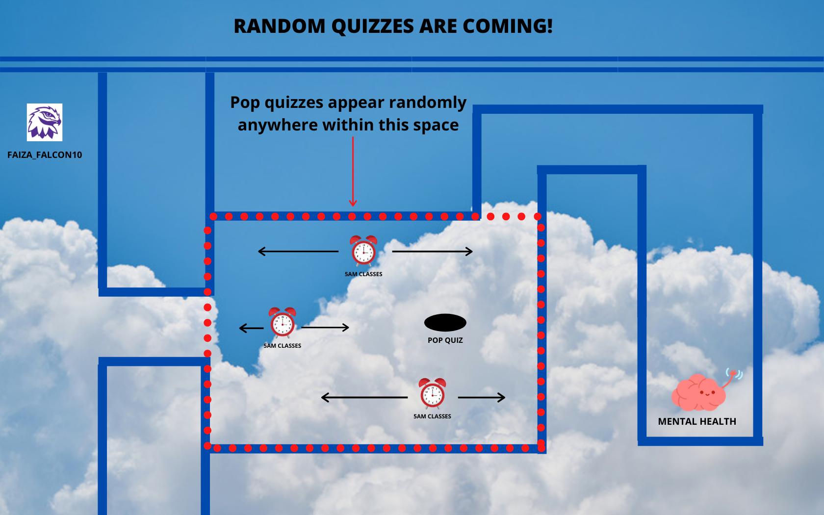

Slide 11
Assignments and Anxiety
In the upcoming levels, the maze is removed in order to increase the playing area.
Two new obstacles are introduced: Assignments and Anxiety.
Anxiety follows the player wherever they go.
Assignments are spawned at random locations and are fired towards the player’s coordinates.

Slide 12
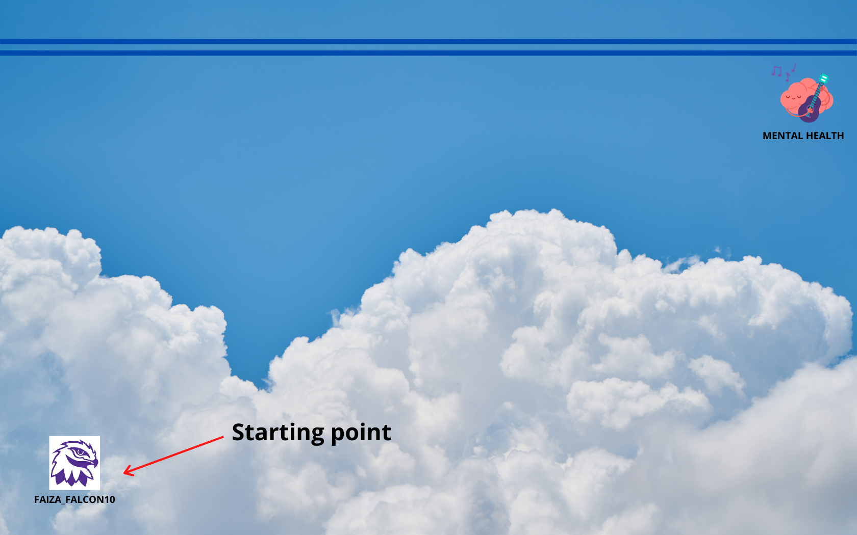

Slide 13
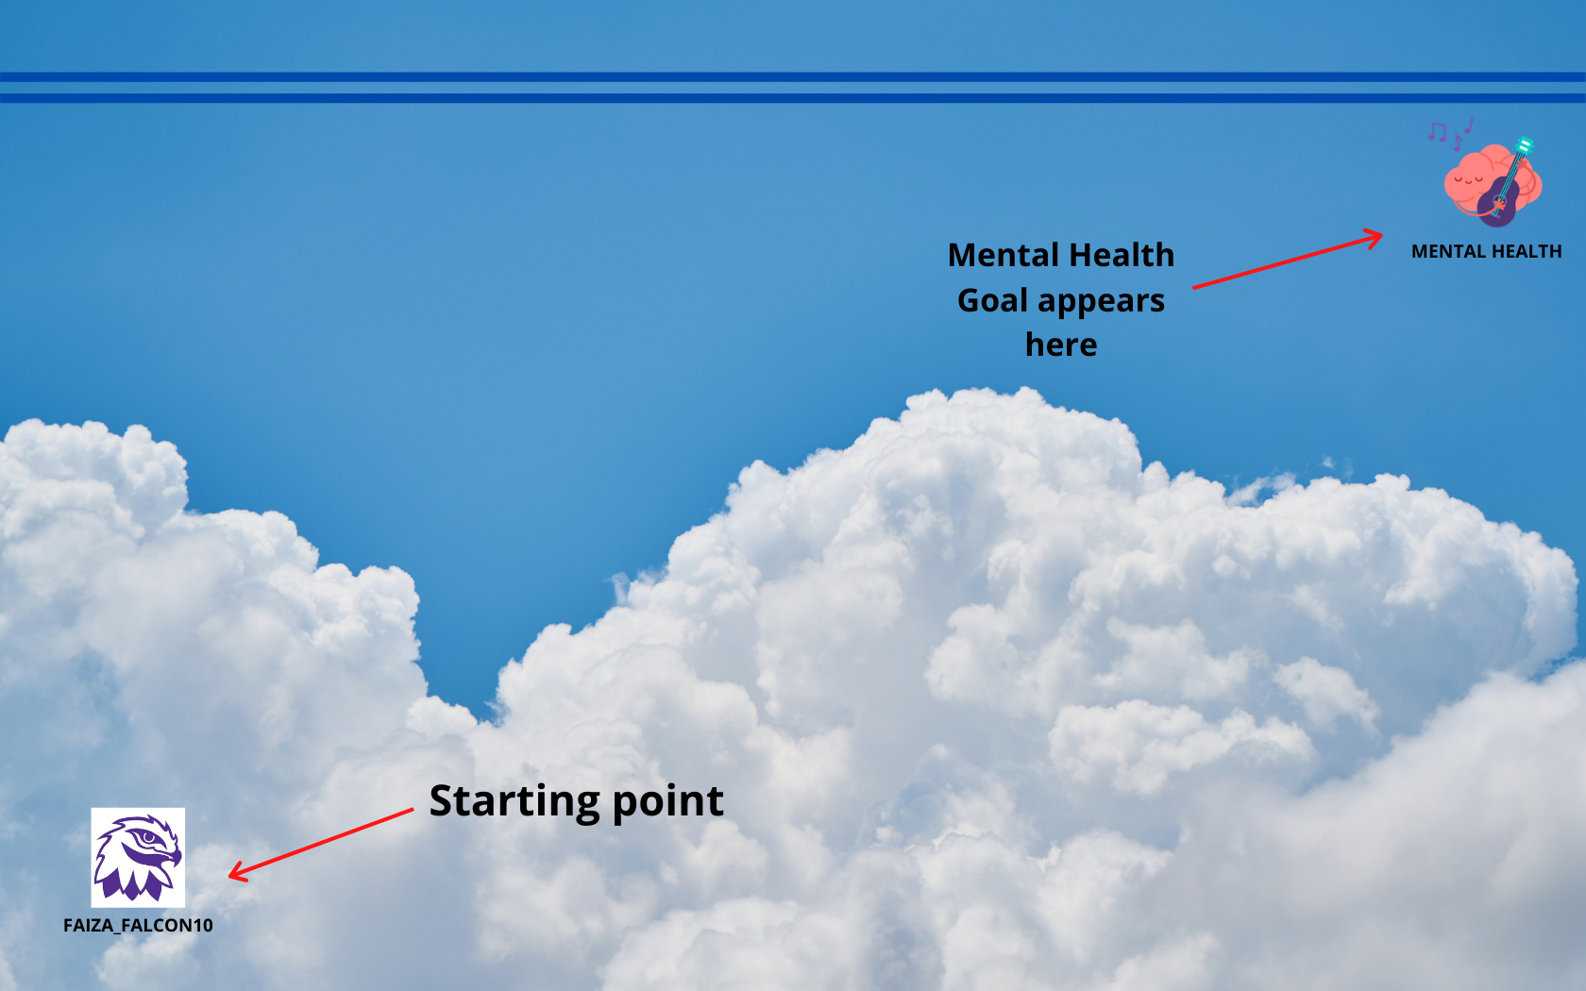

Slide 14
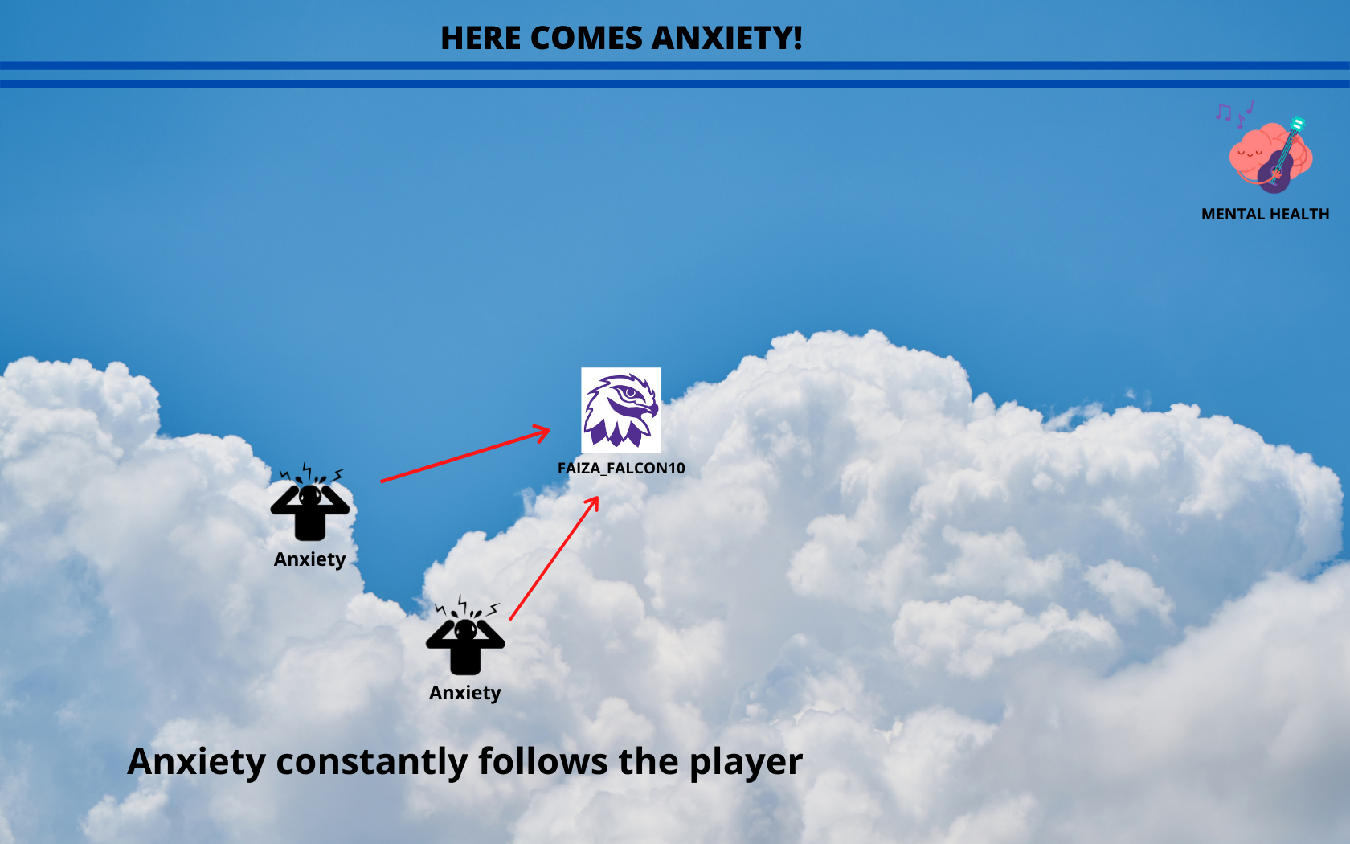

Slide 15
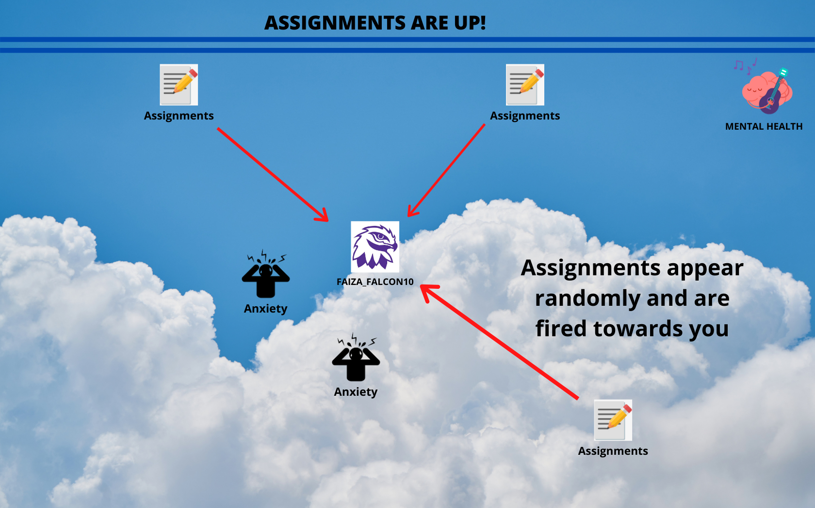

Slide 16
Final Level
The last part of this game is about getting that 4.0 GPA.
The player needs to avoid a set of distractions moving randomly on the screen and get to the 4.0.
The rules of collision are similar to that of the previous levels.
A new counter records the number of collisions with the distractions.

Slide 17
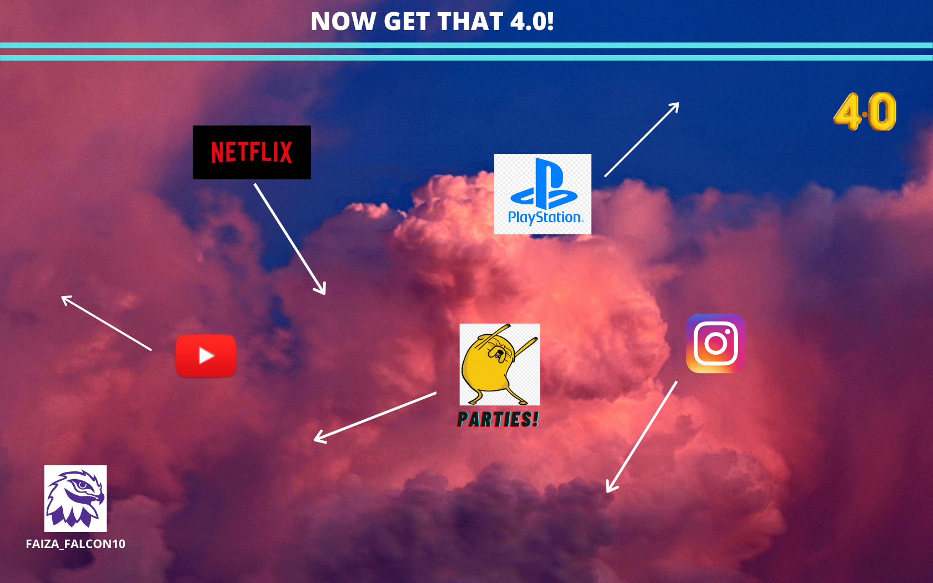

Slide 18
Game Over
The game ends after the 4.0 GPA is achieved.
The player’s score is shown as follows:
‘x breakdowns and y distractions later, you finally got a 4.0! Think you can do better? Click on the screen to play again.’
Upon clicking on the screen, the game starts again.

Slide 19
Division Of Work
Since this is a level-based game, we plan on addressing it level by level.
First couple of levels and basic game structure (sprites, maze, movements etc.) – both
Levels 3-6 – Abraiz
Levels 7-10 – Maaz

